Slide 1
Turn-to-Diarize: Online Speaker Diarization Constrained by Transformer Transducer Speaker Turn Detection
Authors: Wei Xia, Han Lu, Quan Wang, Anshuman Tripathi,
Yiling Huang, Ignacio Lopez Moreno, Hasim Sak
Presented by: Quan Wang
Notes:
Paper: https://arxiv.org/abs/2109.11641

Slide 2
Part 1:
Introduction

Slide 3

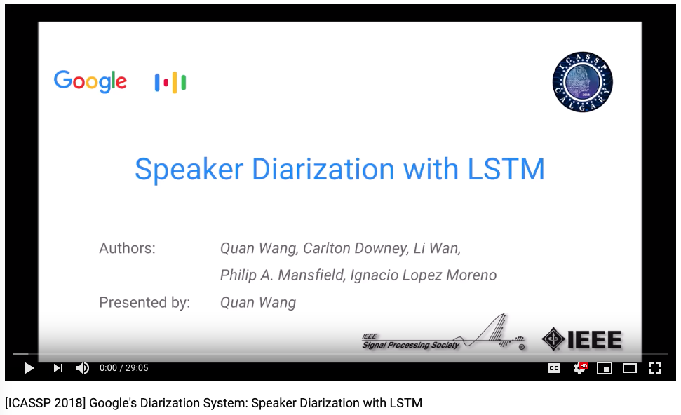
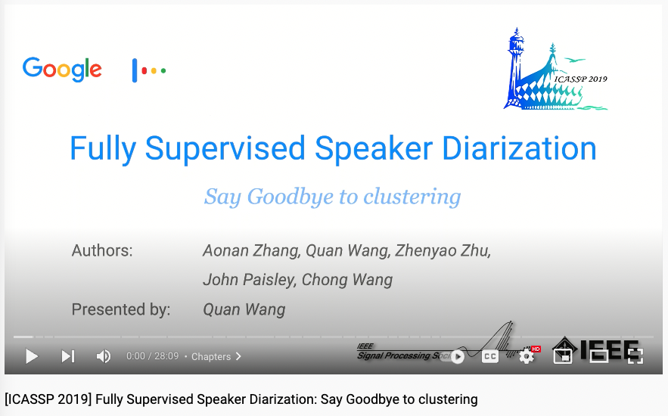
Follow our previous work: Watch these videos
https://www.youtube.com/watch?v=pjxGPZQeeO4
https://www.youtube.com/watch?v=pGkqwRPzx9U

Slide 4
Recap: What is speaker diarization?
The process of partitioning an input audio stream into homogeneous segments according to the speaker identity
“Who Spoke When?”
Speaker 1
Speaker 2

Slide 5
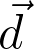
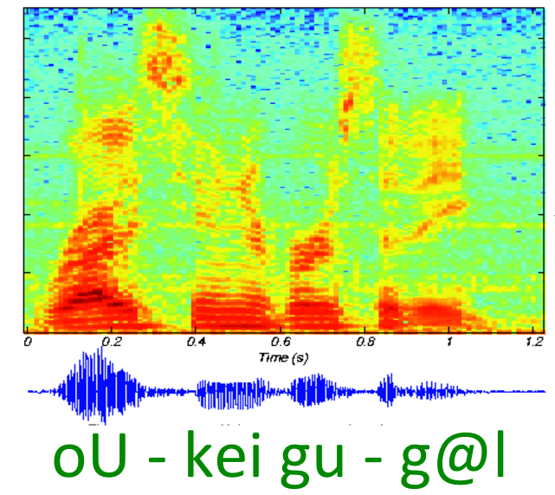
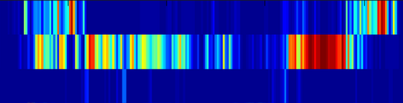
Recap: Speaker recognition with d-vector
LSTM
Cell
LSTM
Cell
LSTM
Cell
LSTM
Cell
LSTM
Cell
LSTM
Cell
LSTM
Cell
LSTM
Cell
LSTM
Cell
Audio segment
Multi-layer LSTM network
D-vector
Wan, Li, Quan Wang, Alan Papir, and Ignacio Lopez Moreno. “Generalized end-to-end loss for speaker verification.” In 2018 IEEE International Conference on Acoustics, Speech and Signal Processing (ICASSP), pp. 4879-4883. IEEE, 2018.

Slide 6
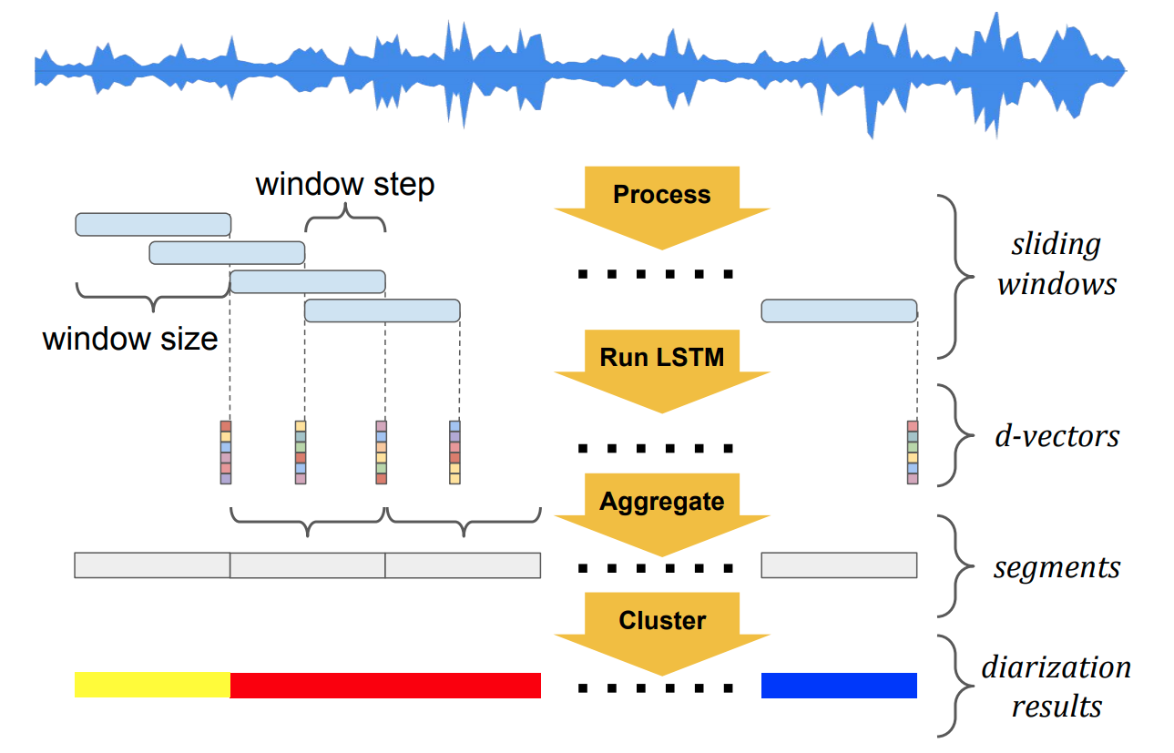
Recap: Baseline “dense d-vector” diarization system
Wang, Quan, Carlton Downey, Li Wan, Philip Andrew Mansfield, and Ignacio Lopz Moreno. “Speaker diarization with LSTM.” In 2018 IEEE International Conference on Acoustics, Speech and Signal Processing (ICASSP), pp. 5239-5243. IEEE, 2018.

Slide 7



The rise of supervised diarization!
Fully supervised approaches for diarization became popular!
They replace the unsupervised clustering algorithms
Representative works:
UIS-RNN, ICASSP 2019
Discriminative Neural Clustering, SLT 2021
Permutation invariant training (E2E diarization)
Google Patent 2018
Interspeech 2019

Slide 8
Annotating the training data
To train a supervised diarization model, what kind of data do we need?
Conversational audio
Time-annotated speaker labels, e.g.:
start: 0.0, end: 1.2, speaker: A
start: 1.3, end: 4.4, speaker: B
start: 6.7, end: 9.4, speaker: A
This kind of annotation is extremely expensive and error-prone!
Annotator needs to frequently go back to compare with previous speakers
Single pass annotation of 10 min of audio takes about 2 hours!

Slide 9
Part 2:
Speaker turn detection

Slide 10
How to make annotations easier?
From “who spoke when” to “who spoke what”
In most applications of diarization, we care about “what” more than “when”
“what” means the text transcript from ASR
start: 0.0, end: 1.2, speaker: A
start: 1.3, end: 4.4, speaker: B
start: 6.7, end: 9.4, speaker: A
spkA: good morning
spkB: morning how are you
spkA: good what about you
Who spoke when
Who spoke what

Slide 11
How to make annotations easier?
From “speaker labels” to “speaker turns”
Annotating speaker labels requires frequently checking previous speakers from long term history
Annotating speaker turns:
Only focuses on short term context
Minimal incremental efforts on top of regular ASR annotation
spkA: good morning
spkB: morning how are you
spkA: good what about you
good morning <st>
morning how are you <st>
good what about you <st>
Speaker labels
Speaker turns

Slide 12
Motivation
Speaker turn annotations are much easier to obtain at large scale, compared with time-annotated speaker labels
How can we make use of them for speaker diarization?
Train an ASR-alike speaker turn detection model
Compute turn-wise speaker embeddings
Use speaker turns to constrain the unsupervised clustering algorithm

Slide 13
Speaker turn detection
We treat speaker turn as a new special token <st>
It is jointly trained with the ASR model
good morning morning how are you good what about you
good morning <st> morning how are you <st> good what about you <st>
Transcript to train ASR
Transcript to train ASR + speaker turn

Slide 14
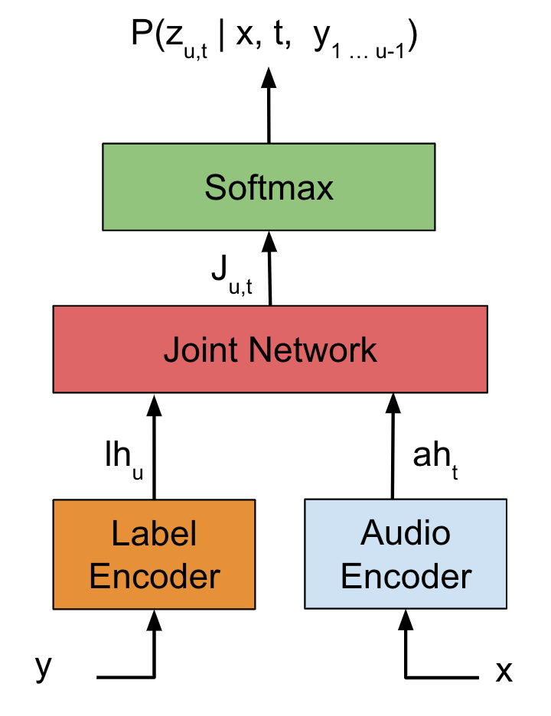
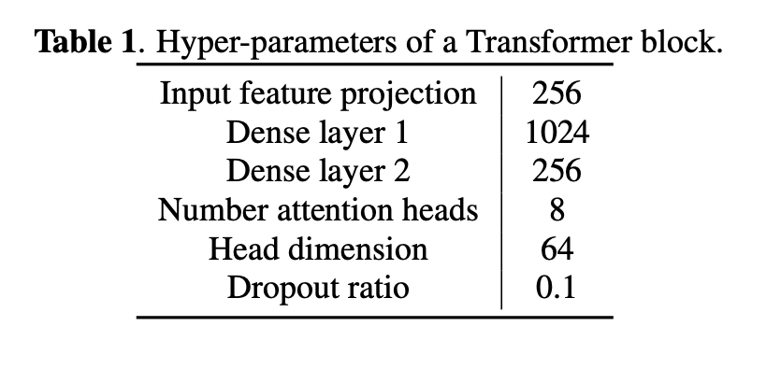
Transformer transducer model
We use the transformer transducer architecture
Zhang, Qian, et al. "Transformer transducer: A streamable speech recognition model with transformer encoders and RNN-T loss." ICASSP. IEEE, 2020.
75 possible graphemes in the output

Slide 15
Part 3:
Turn-to-Diarize

Slide 16
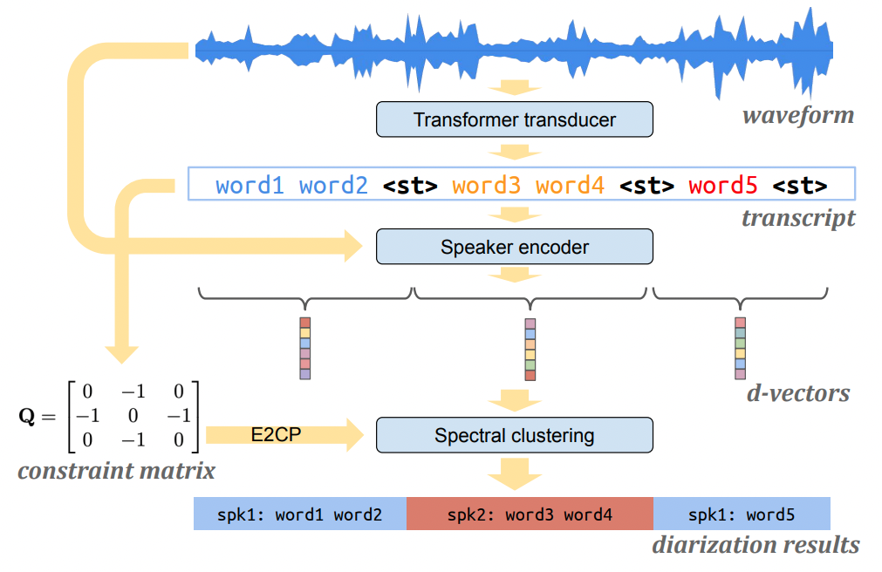
System architecture

Slide 17
Core components
Speaker turn detection
Use the transformer transducer jointly trained with ASR
If a turn is longer than 6 seconds, insert a “fake turn” (compensate for false rejects)
Speaker encoder
The d-vector model
Reset states at speaker turn boundaries
One embedding for each turn (instead of fixed-length segment)
Spectral clustering
Cluster the turn-wise d-vectors – makes clustering drastically cheaper!
Constrained by speaker turns

Slide 18
Spectral clustering (unconstrained)
Basic steps:
Construct an affinity matrix based on cosine similarities
Refine the affinity matrix:
No Gaussian blur (only useful for dense d-vectors)
Row-wise soft-thresholding with auto-tune
Symmetrization
Eigen-decomposition of Laplacian matrix
Estimate number of speakers via eigen-gap
K-means on re-normalized spectral embeddings

Slide 19
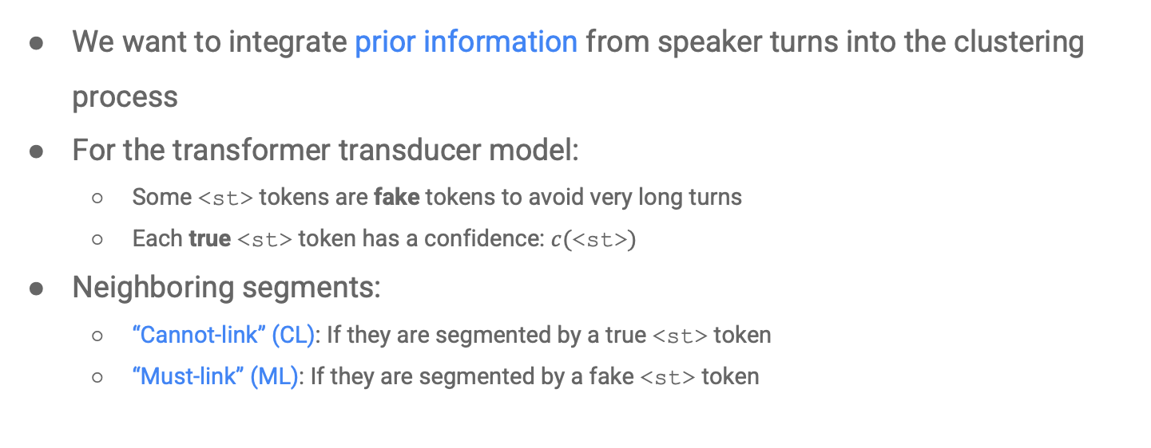
Speaker turn priors
We want to integrate prior information from speaker turns into the clustering process
For the transformer transducer model:
Some <st> tokens are fake tokens to avoid very long turns
Each true <st> token has a confidence: $c(\text{<}\text{st}\text{>})$
Neighboring segments:
“Cannot-link” (CL): If they are segmented by a true <st> token
“Must-link” (ML): If they are segmented by a fake <st> token

Slide 20
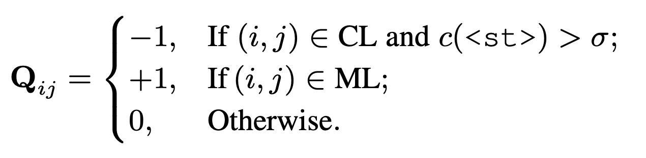
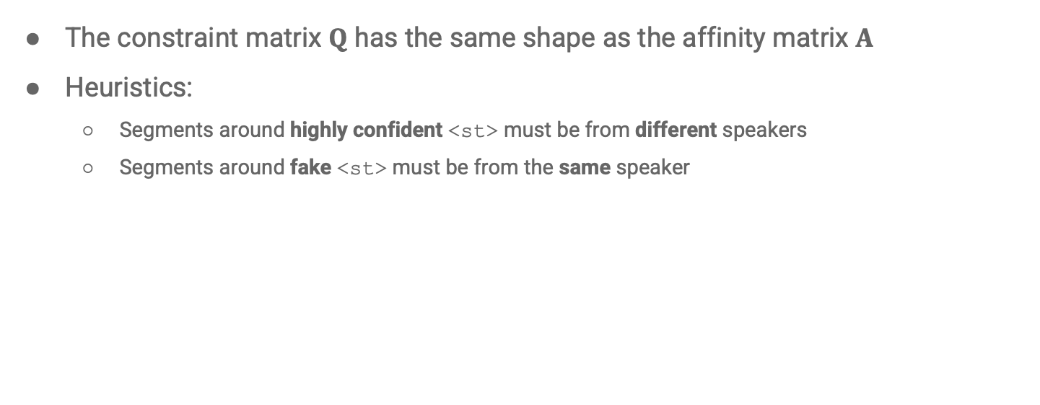
Constraint matrix
The constraint matrix $Q$ has the same shape as the affinity matrix $A$
Heuristics:
Segments around highly confident <st> must be from different speakers
Segments around fake <st> must be from the same speaker

Slide 21
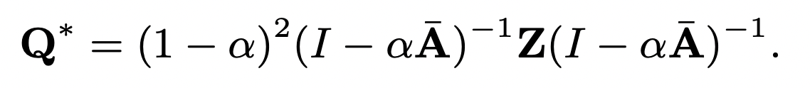
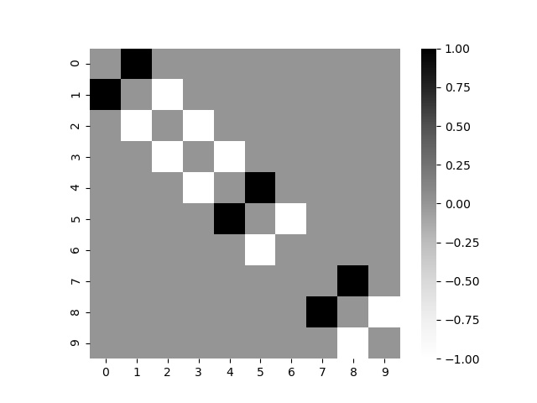
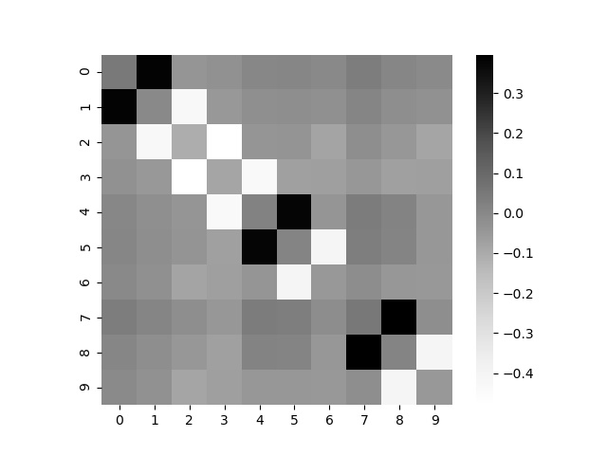
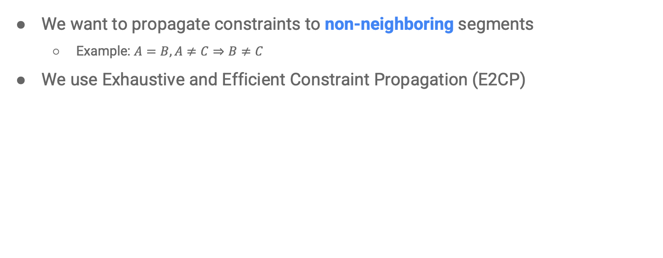
Propagating the constraints
We want to propagate constraints to non-neighboring segments
Example: $A=B,A≠C⇒B≠C$
We use Exhaustive and Efficient Constraint Propagation (E2CP)
E2CP

Slide 22
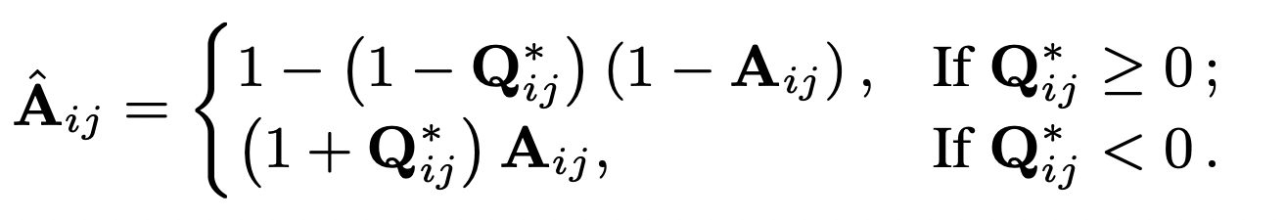
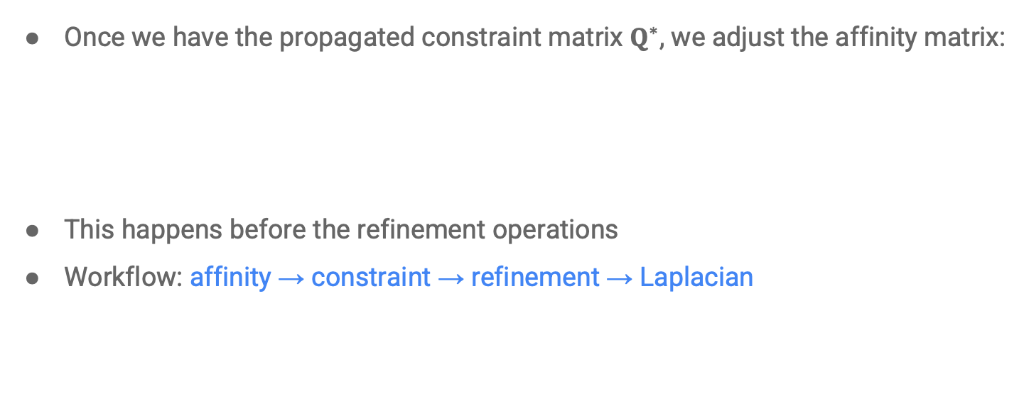
Constrained spectral clustering
Once we have the propagated constraint matrix $Q^{∗}$, we adjust the affinity matrix:
This happens before the refinement operations
Workflow: affinity → constraint → refinement → Laplacian

Slide 23
Part 4:
Experiments

Slide 24
Datasets
Speaker turn detection training sets:
Fisher, Callhome American English (training subset), ~7500 hours of YouTube videos (internal)
Speaker encoder training sets:
Vendor collected speech queries (37 locales), LibriVox, CN-Celeb, TIMIT, VCTK
Diarization eval sets:
“Outbound” telephone speech: 450 conversations, each with 2 speakers
“Inbound” telephone speech : 250 conversations, each with 2~10 speakers
Callhome American English (eval subset)

Slide 25
Experiment protocol
We compare two systems:
“Dense d-vector”: Cluster d-vectors from fixed-length segments (400ms)
“Turn-to-diarize”: Cluster d-vectors from speaker turns (max 6s, average ~4s)
We report:
Confusion and Diarization Error Rate (DER)
Floating point operations to process one second of audio (FLOP/s) after 10min and 1h
Assume clustering runs every 4s
Assume auto-tune searches 10 steps

Slide 26
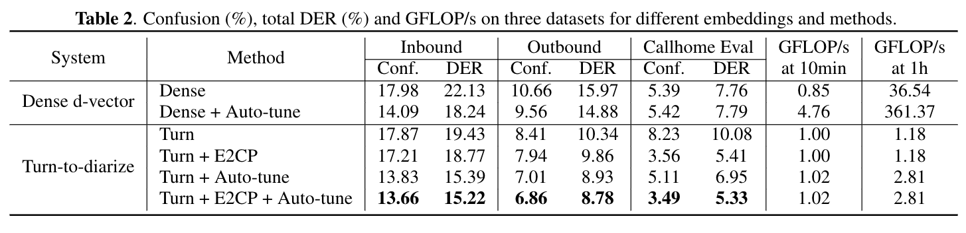
Results: computational cost
Clustering a long sequence of dense d-vectors is extremely expensive
Mostly due to eigen-decomposition
Especially after running for a long time
Even more expensive if we want to auto-tune the refinement threshold

Slide 27
Results: computational cost
Turn-to-diarize made the sequence much shorter!
Clustering becomes very cheap
Even with auto-tune
Even after processing 1h of audio

Slide 28
Results: quality
For turn-to-diarize:
Auto-tune is critical for the performance (especially for >2 speakers)
Speaker turn constraints offer additional improvement

Slide 29
Results: quality
Best turn-to-diarize significantly outperforms best “dense d-vector”

Slide 30
Other benefits
One of the biggest challenges in diarization:
Knowing “when to diarize”
Does this utterance has at least two speakers?
Yes - We need diarization
No - No need of diarization
Turn-to-Diarize allows a “smart mode”:
Start with the transformer transducer only, disable anything else
Only enable speaker encoder and clustering after the first <st> has been detected

Slide 31
Part 5:
Python library

Slide 32
The spectralcluster package
We offer a Python re-implementation
Only implements constrained spectral clustering, not the full diarization system
Available at: https://github.com/wq2012/SpectralCluster
Similar APIs with standard scikit-learn clustering algorithms
Unit tests with >90% coverage
Detailed documentation
PyPI packaging:
$ pip3 install spectralcluster

Slide 33
Features
Refinement operations on affinity matrix
Different types of Laplacian matrix
Customized distance for K-means
Auto-tune of the threshold
Constrained spectral clustering with E2CP
Built-in configurations used by our paper:
from spectralcluster import configs
labels = configs.turntodiarize_clusterer.predict(embeddings, constraints)

Slide 34
Part 6:
Conclusions and future work

Slide 35
Conclusions
We proposed Turn-to-Diarize:
Easier annotation: No need for time-annotated speaker labels, just need speaker turns in transcripts
Transformer transducer model for joint ASR and speaker turn detection
One speaker embedding for each turn
Constrained spectral clustering via E2CP
Experimental results:
Drastically reduces computational cost of clustering
Significant improvement with auto-tune and E2CP
Outperforms the best dense d-vector system

Slide 36
Future work
Multilinguality
Our current transformer transducer model is only trained with English
We want to train on massively multilingual datasets to generalize to more languages
Multimodality
The constrained spectral clustering idea can generalize to other modalities
E.g. visual signals, which offer stronger confidence on user identities

Slide 37
Questions?

